Slide 1
Module III - Case Studies
For cross-policy making and related project design and planning
In cooperation with

Slide 2
Overview of case studies
Region | Scale (local, regional, national, transboundary) | Sectors (water, agriculture, energy) | Solutions (technical, nature-based, governance, focus on challenges)
Central Asia
Water distribution in the Aral Sea basin, Central Asia

Slide 3
Water distribution in the Aral Sea basin
Central Asia

Slide 4
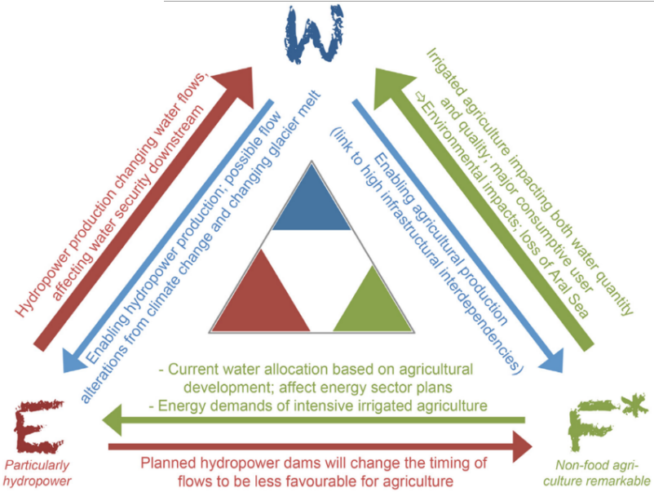
Aral Sea basin case study (central Asia)
Source: Keskinen et al., 2016
Notes:
Notes:
The Aral Sea basin is shared by eight countries in central Asia, with water discharging into the Aral Sea via two major rivers. The climate is sharply continental, and the lowland areas are characterised by high evaporation rates. Water reservoirs and hydropower plants have been built in the basin, and major canals serve irrigation, though the condition of the irrigation infrastructure is poor, and agricultural water use efficiency is also low (Granit et al., 2012).
Keskinen et al. (2016) developed a “Nexus triangle” concept summarising key Nexus interconnections and the relevance of each Nexus sector in different transboundary river basins. This slide presents the Nexus triangle for Central Asia, with key connections and impacts as well as current levels of security described with text. The asterisk assigned to the ‘F’ indicates that food sector also includes a very important non-food crop, i.e. cotton.
The purpose of presenting the Aral Sea Basin case study is to show how water can be inequitably distributed within a basin as a result of overexploitation of water resources. In the mountainous areas of the upstream countries a large quantity of water is available. Downstream countries, such as Uzbekistan, are abstracting a large portion of the available water resources for unsustainable irrigation uses (e.g. cotton for exporting). Upstream countries use the water to produce hydropower, controlling the release of the water based off set quotas, which is often not compatible with downstream irrigation needs.
Sources:
Granit, J., Jägerskog, A., Lindström, A., Björklund, G., Bullock, A., Löfgren, R., de Gooijer, G. & Pettigrew, S. (2012), ‘Regional Options for Addressing the Water, Energy and Food Nexus in Central Asia and the Aral Sea Basin’, Water Resources Development, vol. 28, No. 3, pp. 419-432.
Keskinen, M., Guillaume, J.H.A., Kattelus, M., Porkka, M., Räsänen, T.A. & Varis, O. (2016), ‘The Water-Energy-Food Nexus and the Transboundary Context: Insights from Large Asian Rivers’, Water, vol. 8, Iss. 5, doi:10.3390/w8050193

Slide 5
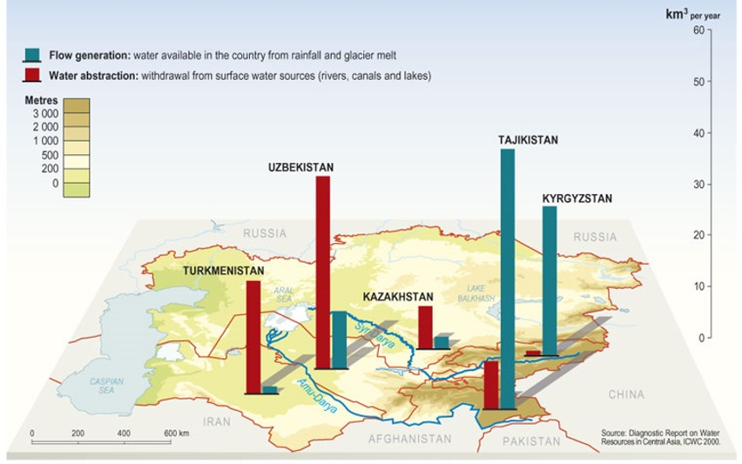
Water withdrawal and availability in the Aral Sea basin
Source: UNEP, 2006
Notes:
Notes:
This slide highlights the stark difference in water resources availability and uses in the upstream and downstream countries of the basin.
Due to irrigation, the groundwater levels have risen sharply in some irrigation areas, for example some parts of Turkmenistan have seen groundwater levels rise by 2.5 m. Given the high evaporation rates in the lowlands of the basin, intensive soil salinisation has resulted, thus affecting agriculture. (Granit et al., 2012)
There is also a projected reduction in long-term glacial runoff due to climate change impacts (Granit et al., 2012).
Source:
Granit, J., Jägerskog, A., Lindström, A., Björklund, G., Bullock, A., Löfgren, R., de Gooijer, G. & Pettigrew, S. (2012), ‘Regional Options for Addressing the Water, Energy and Food Nexus in Central Asia and the Aral Sea Basin’, Water Resources Development, vol. 28, No. 3, pp. 419-432.
United Nations Environment Programme (UNEP) (2006), Water withdrawal and availability in Aral Sea basin. Available from: http://envsec.grid.unep.ch/centasia/index.php

Slide 6
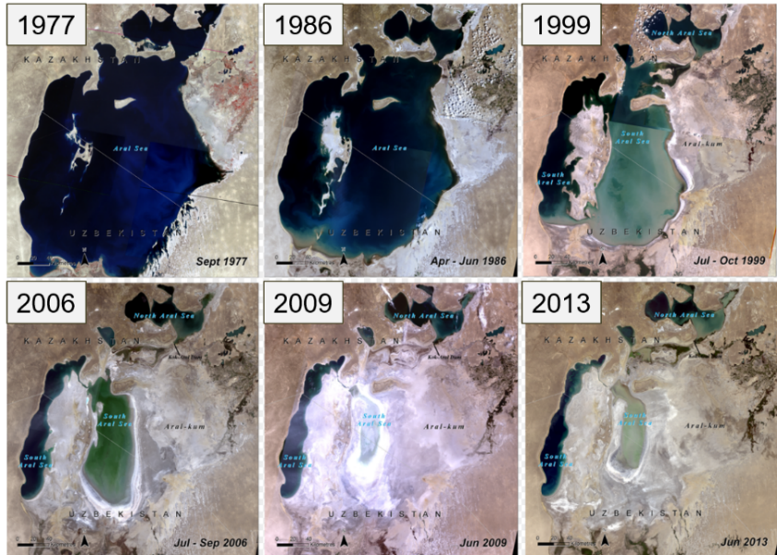
Aral Sea basin: environmental consequences
Source: UNEP, 2014
Notes:
Notes:
After the altering of the natural water flows and intense use of surface water resources, the Aral Sea basin has shrunk to approximately 10% of its former surface area, and less than 10% of its former volume. Consequences of this geographic alteration have been the collapse of the fishing industry, compromised drinking water, soil salinisation and the proliferation of dust storms due to the formation of a man-made desert. These dust storms carry and spread sand and dust that has been contaminated by human activities (e.g. use of pesticides and fertilisers). (UNEP, 2014)
Despite these environmental consequences, parties are currently unable to resolve disputes or work in cooperation, with some parties concerned that serious conflicts could evolve, potentially war (Collado, 2015).
Sources:
Collado, R.E. (2015), ‘Water War in Central Asia: the Water Dilemma of Turkmenistan’, Geopolitical Monitor, Available from: https://www.geopoliticalmonitor.com/water-war-in-central-asia-the-water-dilemma-of-turkmenistan/
United Nations Environment Programme (UNEP) (2014), ‘The future of the Aral Sea lies in transboundary co–operation’, Available at: https://na.unep.net/geas/getUNEPPageWithArticleIDScript.php?article_id=108

Slide 7
Thank you for your time!
In cooperation with

