Slide 1


Gender equity and social inclusion in the
Water-Energy-Food-Ecosystems (WEFE) Nexus
Frameworks and tools for moving from resource-centric to
people-centric WEFE Nexus approaches
Notes:
Welcome to the learning module on gender equity and social inclusion in the water–energy–food–ecosystems (WEFE) Nexus. The module provides frameworks and tools for moving from resource-centric to people-centric Nexus approaches.

Slide 2












Let’s get back to the city of Mostanova…
Ms. Adila
Notes:
Notes:
[Storytelling Intro – adjust names to local context]
Let’s get back to the city of Mostanova.
Ms Adila is agricultural development specialist at the city administration. She works closely with Ms Sinclair, the head of city administration who we met during the previous lessons.
The water resource that the city’s hydropower plant, an industrial farm, and several small agricultural communities rely on, has become scarce after a period of extreme drought. The situation is aggravated by land development projects that dried up some of the wetlands surrounding the city.
Who will decide how the water resource will be managed?
Who will decide what’s most important?
Will representatives from each stakeholder group sit down to create a fair use agreement?
Will the needs of the marginalised community members be presented?
Or will the stakeholders with the most economic and political influence leverage their power?
Will anyone consider the interplay of water, food, energy, and ecosystem security?
It is easy to see how politics and underlying power structures will play a major role in the management of the scarce resources, how the impacts on the use of one resource will spill over to other sectors, and how the most marginalised stakeholders risk losing out on the key resources that sustain their livelihoods.
Ms Adila, Ms Sinclair and their colleagues at the other departments need to work with stakeholders to identify their needs and interests, manage conflicts in the tense situation, and try to together come up with fair solutions.
-------
This example from Mostanova brings us straight to the topic of this training which is about gender equity and social inclusion in the Water–Energy–Food–Ecosystems Nexus and what kind of frameworks and tools can help to move from resource-centric to people-centric Nexus approaches.

Slide 3
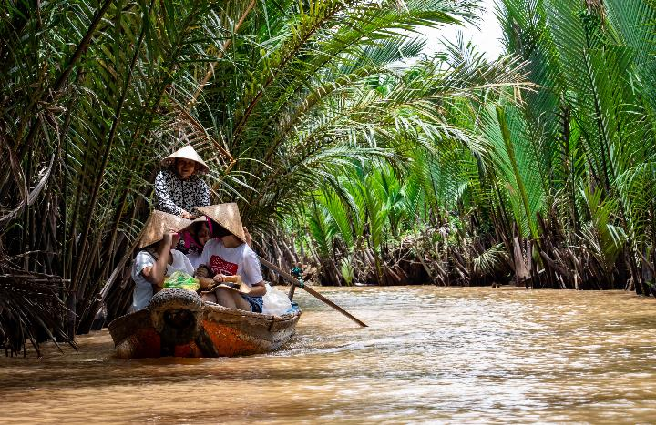
Politics and underlying power structures play a major role in managing the water–energy–food–ecosystems (WEFE) Nexus. The most marginalised stakeholders risk losing out on critical resources.
© Tomáš Malík / Pexels
Notes:
Past examples from the real world show how competition over resources within the Water-Energy-Food-Ecosystems Nexus has played out. Politics and underlying power structures play a major role in managing the Nexus, and the most marginalised stakeholders such as women, landless and ethnic minority groups, often end up losing out on critical resources.
In one example from the Mekong Delta of Viet Nam, hydropower dams benefit distant communities in China and have been constructed despite local counter-demonstrations. These dams are producing harmful effects on local fisheries and threaten the livelihoods and nutritional security of rural Mekong Delta communities.^{1, 2}
The Mekong Delta is far from the only hotspot, however. More than 730 million people currently live in countries with high and critical levels of water stress, 1.6 billion people stand to lack access to safe drinking water by 2030, and 2.4 billion people rely on inefficient and polluting cooking systems.³
Addressing these challenges in an integrated way is thus critical to the livelihoods of billions of people – but development interventions may miss their targets and harm the very populations they seek to benefit, if they do not carefully embed gender and social inclusion considerations.^{4, 5}
Developing the Water–Energy–Food–Ecosystems Nexus in sustainable and equitable ways to meet multiple stakeholders’ needs will require moving away from a narrow, technical resource focus to consider aspects of gender equity and social inclusion.
References:
¹ Orr, S., Pittock, J., Chapagain, A., & Dumaresq, D. (2012). Dams on the Mekong River: Lost fish protein and the implications for land and water resources. Global Environmental Change, 22(4), 925-932. https://doi.org/10.1016/j.gloenvcha.2012.06.002
² Middleton, C. (2014). The politics of uncertainty: Knowledge production, power and politics on the Mekong River. In: Proceedings of the International Conference on Development and Cooperation of the Mekong Region. Seoul, South Korea (pp.4-5).
³ United Nations (2022). The Sustainable Development Goals report. https://unstats.un.org/sdgs/report/2022/
⁴ Sachs, C. (2020). Gender, agriculture and agrarian transformations. In: Sachs, C. (Ed.), Gender, agriculture and agrarian transformations changing relations in Africa, Latin America and Asia (pp. 3-8). Routledge and CRC Press.
⁵ Pyburn, R., & van Eerdewijk, A. (Eds.). (2021). Advancing gender equality through agricultural and environmental research: Past, present, and future. Washington, D.C. (USA): IFPRI. https://doi.org/10.2499/9780896293915

Slide 4

Outline
1: Introduction | Learning objectives Key terms
2: From resource- to people-centric WEFE Nexus approaches | Current WEFE Nexus thinking: focus on resources over people Gender equity and social inclusion: the missing links in WEFE Nexus approaches
3: A social equity framework for addressing gender equity and social inclusion in the WEFE nexus | Recognition Representation Redistribution
4: Case study
5: Synthesis
Look out for the “approaches and tools” icon
Notes:
This learning module is divided into five chapters.
Chapter 1 introduces the module and identifies key terms, such as what is meant with Water-Energy-Food-Environment Nexus, Gender equity and social inclusion, tradeoffs, compromises, synergies and externalities. Understanding these will help us identify relevant gender considerations in our work and ways to address those.
Chapter 2 provides an overview of the social dimensions of resource access.
Chapter 3 introduces the social equity framework for addressing gender equity and social inclusion in the nexus.
Chapter 4 uses a case study in Indonesia to understand gender equity and social inclusion considerations in the nexus project cycle.
Chapter 5 is a summary of the learning objectives.

Slide 5
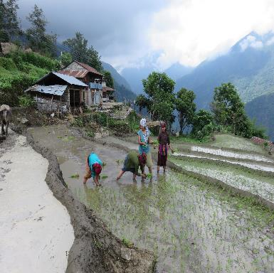
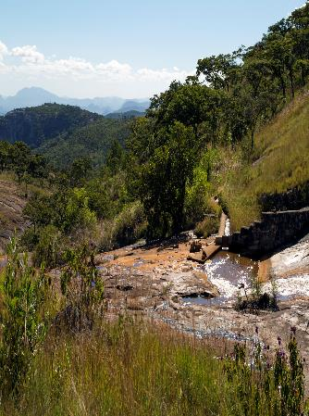
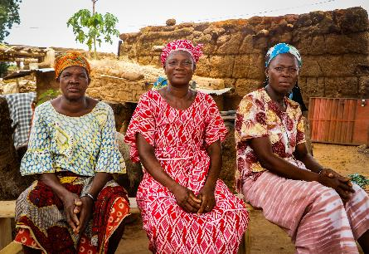
1: Introduction
Learning objectives
Key terms
Notes:
So let’s start with the learning objectives for this module, and the key terms.
Pictures - Sources:
Bottom left: © Manon Koningstein IWMI
Top left: © Subedi LI-BIRD
Right: © David Brazier IWMI

Slide 6



Learning objectives
This learning module shows how gender equity and social inclusion (GESI) considerations can be identified and integrated in WEFE Nexus approaches. Intentionally focusing on GESI during all steps of WEFE initiatives is critical to ensure that these initiatives benefit and do not harm women and other marginalised groups and communities.
At the end of this module, learners will be able to:
Explain the importance of GESI for achieving sustainable development outcomes in the
WEFE Nexus
Describe common GESI challenges and issues that WEFE projects face
Describe the main steps for better addressing GESI considerations
Notes:
This learning module shows how gender equity and social inclusion (GESI) considerations can be identified and integrated in WEFE approaches. Intentionally focusing on GESI in designing, implementing and monitoring WEFE initiatives is critical to ensure that these initiatives benefit and do not harm women and other marginalised groups and communities.
At the end of this module, learners will be able to:
Explain the importance of gender equity and social inclusion (GESI) for achieving sustainable development outcomes in the WEFE Nexus,
Describe common GESI challenges and issues that WEFE projects face,
Describe the main steps for better addressing GESI considerations.
This module is intended for a broad audience that is working on, or interested in, cross-sectoral issues around sustainable use of water, energy, food and ecosystems, including:
Decision-makers in public and private sectors as well as from civil society
Practitioners and project implementers
Graduate students and researchers
Donors
The module is designed to be accessible to audiences from a variety of disciplinary backgrounds, from water management, agriculture, forestry, ecology and economics to social sciences.

Slide 7
Key terms
The WEFE Nexus refers to the interactions between people and ecosystems across the interrelated water, energy, food and environment sectors.
Gender equity and social inclusion (GESI) aims to foster equal rights, responsibilities and opportunities for men and women, independent of age, ethnicity, social status or other characteristics.
A social equity framework helps to understand equity and ways to promote it across three dimensions: recognition, representation and redistribution.
Externalities (or external costs) happen when the costs of production or consumption of goods and services are not fully reflected in the prices charged, and so outsiders have to bear part of the costs.
Trade-offs and compromises: A ‘trade-off’ is when one objective is sacrificed in favour of another. A ‘compromise’ happens when a less-than-ideal result is accepted for a common good.
Synergies happen when one intervention helps achieve multiple Nexus objectives in a
‘win–win–win’ for more sustainable, prosperous and equitable development.
Notes:
The Water-Energy-Food-Ecosystems Nexus (or WEFE Nexus) refers to the interactions between people and ecosystems across the interrelated water, energy, food and environment sectors.
Gender equity and social inclusion (GESI) aims to foster equal rights, responsibilities and opportunities for men and women, independent of age, ethnicity, social status or other characteristics.
A social equity framework helps to understand equity and ways to promote it across three dimensions: recognition, representation and redistribution.
A ‘trade-off’ is when one objective is sacrificed in favour of another. A ‘compromise’ happens when a less-than-ideal result is accepted for a common good.
Synergies happen when one intervention helps achieve multiple Nexus objectives in a ‘win–win–win’ for more sustainable, prosperous and equitable development.
Externalities (or external costs) happen when the costs of production or consumption of goods and services are not fully reflected in the prices charged, and so outsiders have to bear part of the costs. For example, air or water pollution from unsustainable production affect everyone, not only the producers and the consumers involved in trade.
Nexus thinking is an integrated approach to describe and address the complex relations and interdependencies among resources and people, including the trade-offs and synergies involved in managing resources to meet the needs of diverse stakeholders across multiple levels (e.g., local to international) and scales (across space and over time).¹
Reference:
¹ FAO (2014). The water-energy-food nexus: A new approach in support of food security and sustainable agriculture. Rome (Italy): Food and Agriculture Organization of the United Nations. https://www.fao.org/3/bl496e/bl496e.pdf

Slide 8
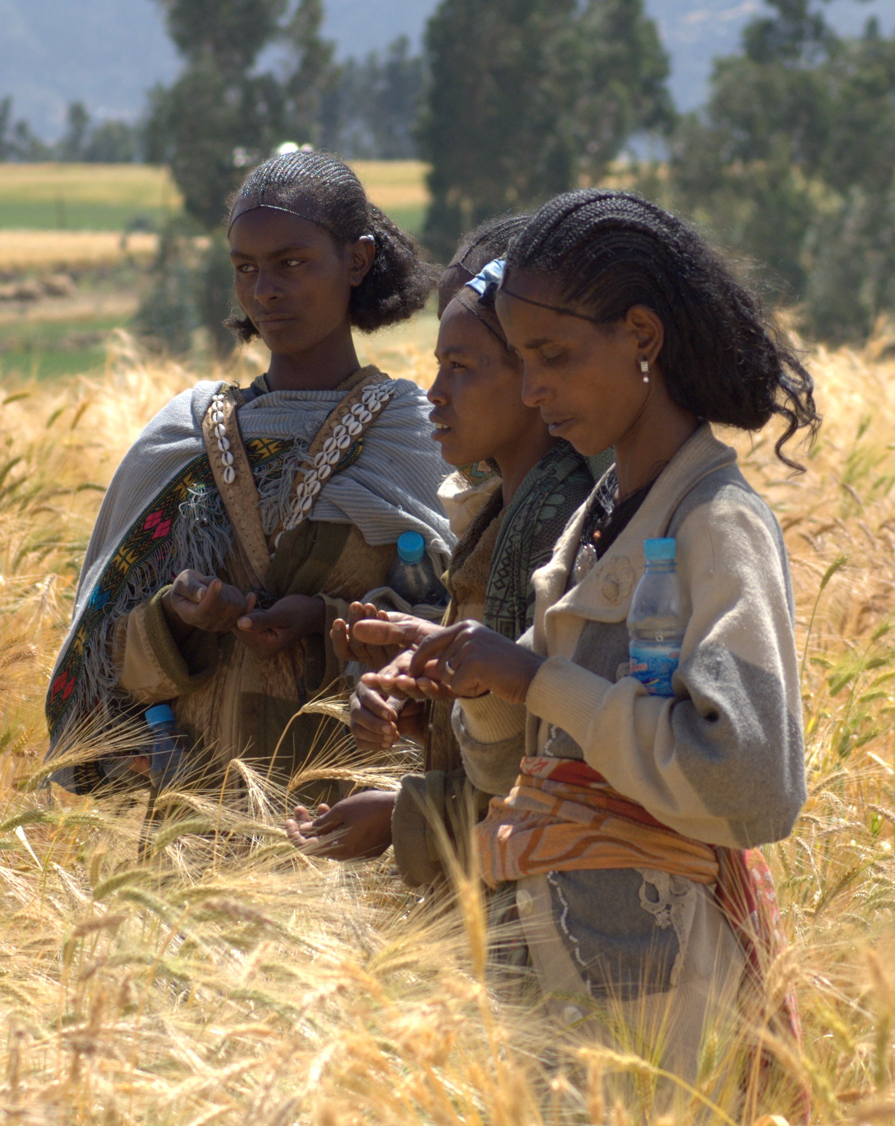
2: From resource- to people-centred WEFE Nexus approaches
Current WEFE Nexus thinking
Gender equity and social inclusion
© J.van de Gevel Bioversity International
Notes:
Let‘s now look at the origins of WEFE Nexus thinking and what it means for considering gender equity and social inclusion in designing and implementing Nexus interventions

Slide 9



Current WEFE Nexus thinking: focus on resources over people
WEFE Nexus approaches seek to manage trade-offs, reduce inefficiencies and increase synergies at a systems level among water, energy, food, ecosystems and other land use sectors.
Notes:
WEFE Nexus approaches seek to manage trade-offs, reduce inefficiencies and increase synergies at a systems level among water, energy, food, ecosystems and other land use sectors.
Nexus approaches differ from traditional, sector-specific policies and practices because they do not focus on productivity gains within individual sectors. By accounting for the interactions between resource use in different sectors, nexus approaches can support the shift towards increased resource use efficiency and more sustainable consumption patterns.¹
However, nexus thinking has traditionally been resource-focused and has overlooked the social, economic, political and cultural dynamics that shape resource use.
Reference:
¹ Hoff, H. (2011) Understanding the nexus. Background Paper for the Bonn 2011 Conference: The Water, Energy and Food Security Nexus. Stockholm (Sweden): Stockholm Environment Institute (SEI).

Slide 10
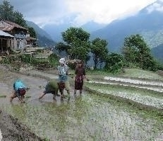
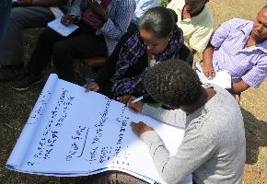
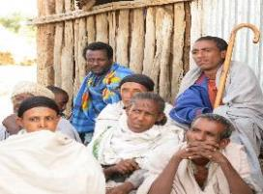
Gender equity and social inclusion: the missing links in WEFE Nexus approaches
Around the world, we see persistent gender inequalities in access to resources and decisions over how to use and manage these.
Too often, women
are left out of development and environmental
initiatives, since they are not seen as legitimate
stakeholders.
Women (and men) are
heterogeneous groups and may have vastly
different experiences based on other social factors.
Many categories of men also experience
marginalisation.
By addressing these inequalities across sectors in policy and practice, Nexus approaches can enable more equitable access to WEFE decisions, services and benefits for all.
Left: © Subedi LI-BIRD. Middle and right: © CGIAR Research Program on Water, Land and Ecosystems
Notes:
Gender equity and social inclusion are currently the missing links in many WEFE Nexus approaches.
Around the world, we see persistent gender inequalities in access to resources and decisions over how to use and manage these. Rural women and men particularly rely on land and other natural resources for their livelihoods. But often, only men are recognised as the authorities, providers, farmers and resource managers of their households and communities – even though women, too, are responsible on a daily basis for providing and managing food, water, fuel, cash and other resources.
In general, patriarchal norms give more status, influence and rights to men than women.^{1,2} Too often, women are left out of development and environmental initiatives, since they are not seen as legitimate stakeholders.³
In reality, in their communities, women have unique knowledge of and priorities for the management of resources. They also face different and often unequal risks and rewards than men when it comes to accessing and controlling, governing, using and managing these resources. There are many gender- or inclusion-specific barriers that make it difficult for women to access and progress in decision-making spaces, from underlying societal norms to practical constraints such as time availability and mobility outside of the home. Professionally (i.e., in the workplace), the water, energy and food sectors as they are considered very technical and, thus, due to societal norms, typically associated with men.
Importantly, women (and men) are heterogeneous groups and may have vastly different experiences based on other social factors. For example, poor women in rural areas have different needs and realities with respect to energy or water use than better-off women in cities. Age, marital status, and in some areas, caste or ethnicity, among other factors, will influence their access to resources and how they use and prioritise these. Overall, however, women, in all their diversity, have limited control over management decisions at all levels compared to men.
Many categories of men also experience marginalisation. Men in disadvantaged groups (such as ethnic minorities, lower castes or landless men) may struggle to have their voices heard in their communities and in higher-level governance spaces that shape their local opportunities and resource access in significant ways.
By addressing these inequalities across sectors in policy and practice, Nexus approaches can enable more equitable access to WEFE decisions, services and benefits for all.
References:
¹ Doss, C.R., Quisumbing, A.R., & van den Bold, M. (2015) Gender inequalities in ownership and control of land in Africa: Myth and reality. Agricultural Economics, 46, 1-32. https://doi.org/10.1111/agec.12171
² UN Women (2022). Progress on the Sustainable Development Goals: The Gender Snapshot 2022. Department of Economic and Social Affairs (DESA), UN Women. https://www.unwomen.org/en/digital-library/publications/2022/09/progress-on-the-sustainable-development-goals-the-gender-snapshot-2022
³ Elias, M., Ihalainen, M., Monterroso, I., Gallant, B., & Paez Valencia, A. (2021). Enhancing synergies between gender equality and biodiversity, climate, and land degradation neutrality goals: Lessons from gender-responsive nature-based approaches. Rome (Italy): Bioversity International. https://www.cifor.org/knowledge/publication/8173

Slide 11
Disability
Location
Ethnicity
Caste
Occupation
Community standing
Gender
Social inclusion
Culture
Caste
Land ownership status
Marital status
Parenthood
Age
Wealth
Notes:
This web shows many different aspects of a person’s identity that, together, can lead to their exclusion or inclusion in decision-making and benefit-sharing related to water, energy, food and ecosystems. Advancing gender equity and social inclusion in the WEFE Nexus requires recognising who is excluded and on what basis, to challenge that discrimination. The diagram is not definitive, and the connections between identities can be complex and unique to individuals or communities. Gender is a special aspect of identity in that it cuts across institutions, follows your home, and shows in the most intimate relations of your life in a way that other identities do not.
By addressing these inequalities across sectors in policy and practice, Nexus approaches can enable more equitable access to resource decisions, services and benefits for all. In this way, rather than accentuating inequalities, Nexus approaches that carefully address gender and inclusion can foster poverty reduction, better health and environmental sustainability for a greater diversity of stakeholders.¹ As such, a gender and inclusion perspective has much to contribute to the conversation as Nexus thinking evolves.
References:
¹ Elias, M., Ihalainen, M., Monterroso, I., Gallant, B., & Paez Valencia, A. (2021). Enhancing synergies between gender equality and biodiversity, climate, and land degradation neutrality goals: Lessons from gender-responsive nature-based approaches. Rome (Italy): Bioversity International. https://www.cifor.org/knowledge/publication/8173

Slide 12
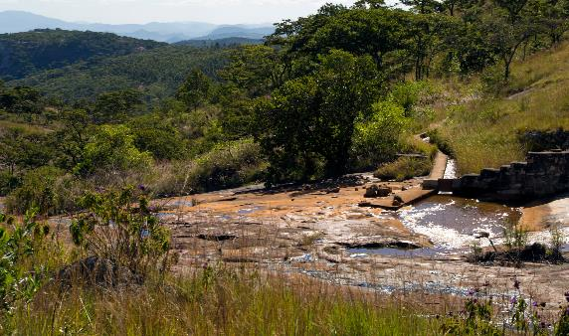
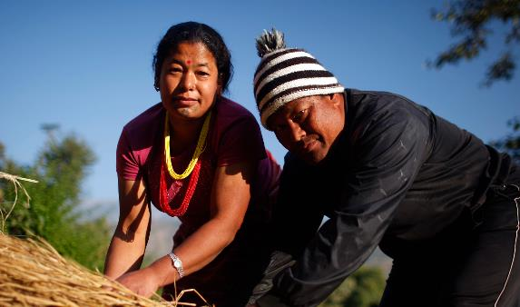
3: A social equity framework for addressing gender equity and social inclusion in the WEFE Nexus
© David Brazier IWMI
© Tom van Cakenberghe IWMI
Notes:
Next, let‘s look at a social equity framework that helps understand what they key considerations are for integrating gender and social inclusion considerations in WEFE Nexus interventions

Slide 13

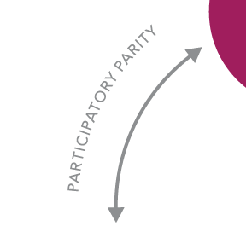
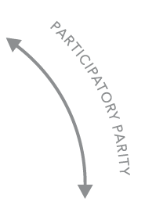


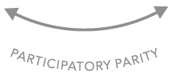
A social equity framework
– the three pillars
RECOGNITION
Who is entitled to dignity and prestige?
REDISTRIBUTION
Who is entitled to capital and assets – natural, physical, human, financial, social?
REPRESENTATION
Who is entitled to claims of injustice?
Notes:
Gender equity and social inclusion strategies can help identify entry points for fostering equitable and sustainable resource access for diverse Nexus stakeholders at different scales. A social equity framework^{1, 2, 3} can help guide this process by drawing attention to the who, the how and why to achieve equitable outcomes in Nexus initiatives.
A social equity framework features three pillars:
Recognition, or the right of those who are affected by, in this case, the WEFE Nexus, to be recognised as legitimate and dignified stakeholders, and to have the value of their knowledge, voices and priorities recognised
Representation, or the right to equally participate in and influence decision-making processes
Redistribution, or more equal rights to the resources and benefits from, in this case, the WEFE Nexus.
These pillars are held together by the guiding principle of participatory parity – or the ability of all members of a society to interact with one another as peers.¹
References:
¹ Fraser, N. (1998). Social justice in the age of identity politics: Redistribution, recognition, participation. WZB Discussion Paper, No. FS I 98-108. Berlin (Germany): Wissenschaftszentrum Berlin für Sozialforschung (WZB).
² Fraser, N. (2005). Mapping the feminist imagination: From redistribution to recognition to representation. Constellations, 12(3), 295-307. https://doi.org/https://doi.org/10.1111/j.1351-0487.2005.00418.x
³ Fraser, N. (2010). Who counts? Dilemmas of justice in a Postwestphalian World. Antipode, 41, 281-297. https://doi.org/10.1111/j.1467-8330.2009.00726.x

Slide 14



Recognition
Recognition refers to when people or social groups have equal opportunities to be valued as legitimate, respected and dignified participants in society.
WEFE Nexus initiatives must identify which social groups can affect, and be affected by, the planned interventions. This helps design interventions so that they enable more equal participation and benefits.
Notes:
The first pillar, Recognition, refers to when people or social groups have equal opportunities to be valued as legitimate, respected and dignified participants in society.
The recognition that a person or social group receives is influenced by the (often hidden) attitudes that society holds towards gender and other social categories, such as age, ethnicity, caste or occupation.^{1,2,3,4,5}
For example, many rural women do as much or more farm work than their spouses but are not recognised as farmers in their own right, and their knowledge and skills are undervalued. As such, they are frequently not considered legitimate (justified or valued) stakeholders in agricultural interventions.
Nexus initiatives must identify which social groups will affect, and be affected by, Nexus interventions. This broad range of stakeholders may include:
Policymakers
Staff of national and local government agencies participating in the implementation of interventions
Intended beneficiaries in all their diversity
Persons or groups who may be affected adversely by the interventions in the short- or long-term, which includes private sector actors, interest groups, civil society organisations and donors.
Understanding the stakeholders, their needs and roles, helps design interventions that enable more equal participation and benefits.
References:
¹ Fraser, N. (1998). Social justice in the age of identity politics: Redistribution, recognition, participation. WZB Discussion Paper, No. FS I 98-108. Berlin (Germany): Wissenschaftszentrum Berlin für Sozialforschung (WZB).
² Fraser, N. (2005). Mapping the feminist imagination: From redistribution to recognition to representation. Constellations, 12(3), 295-307. https://doi.org/https://doi.org/10.1111/j.1351-0487.2005.00418.x
³ Fraser, N. (2010). Who counts? Dilemmas of justice in a Postwestphalian World. Antipode, 41, 281-297. https://doi.org/10.1111/j.1467-8330.2009.00726.x
⁴ Tilly, C. (1998). Durable Inequality. Berkeley (USA): University of California Press.
⁵ Ridgeway, C.L. (2011). Framed by gender: How gender inequality persists in the modern world. Oxford (UK): Oxford University Press.

Slide 15
Recognition
Among stakeholder groups, there are highly unequal power relations. This means that the knowledge and priorities of some may be perceived as having more legitimacy than those of others.
Importantly, from the perspective of social equity, the needs, rights, knowledge systems and priorities of different groups– particularly those most marginalised – must be recognised and legitimised.
LOCAL RIGHTS-HOLDERS
LOCAL STAKEHOLDERS
NATIONAL STAKEHOLDERS
INTERNATIONAL STAKEHOLDERS
Notes:
From the perspective of social equity, the needs, rights, knowledge systems and priorities of different groups must be recognised and legitimised.
The stakeholders come from many levels – from local to national and international – and are not all usually present in the same water, energy, food and ecosystem decision-making spaces. Power relations among stakeholder groups can be highly unequal. This means that the knowledge and priorities of some may be perceived as having more legitimacy than those of others.
Typically, stakeholders with less social and financial capital are the ones who are left out. For example, a decision made in a capital city about rural resources may not include any spokespeople from the impacted rural area. If interventions do not intentionally seek to recognize all stakeholders genuinely, they risk stripping specific communities of their resources to benefit other, more powerful groups.
From a rights-based perspective, those who live near the resources in question and whose livelihoods are directly linked to them deserve particular recognition and protection. In this sense, it is important to make the distinction between two categories. First are rights-holders: those with customary and historical rights to determine the use and access to natural resources in ways that are fundamental to their human rights, such as Indigenous peoples and marginalised groups in local communities. Second are other stakeholders: individuals or groups claiming a stake in a decision-making process, such as political elites or private companies interested in using the resources.¹
A ‘do-no-harm’ principle means that initiatives must ensure, at a minimum, that they do not pose undue risks to local people and marginalised community members (that is, rights-holders) and do not jeopardise their livelihoods and well-being. Nexus initiatives will also have to be accountable to these rights-holders.
Reference:
¹ Armitage, D., Mbatha, P., Muhl, E.-K., Rice, W., & Sowman, M. (2020). Governance principles for community-centered conservation in the post-2020 global biodiversity framework. Conservation Science and Practice, 2(2), e160. https://doi.org/10.1111/csp2.160

Slide 16
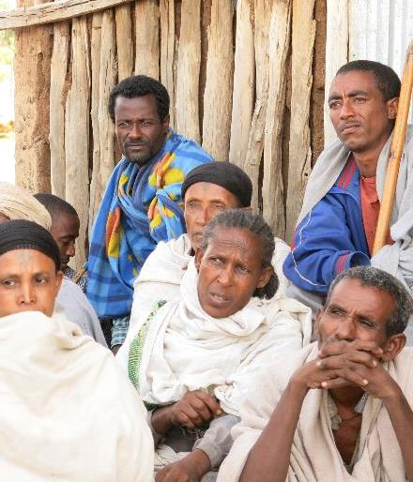
Recognition – Stakeholder Analysis
To make sure that all relevant groups are included in WEFE Nexus decision-making, intervention planning should begin with a stakeholder analysis.
Stakeholder analysis = identifying social groups who may affect and be affected by WEFE Nexus interventions.
Consider all potential stakeholders, including those who may be affected negatively by the WEFE Nexus plans.
© CGIAR Research Program on Water, Land and Ecosystems
Notes:
To make sure that all relevant groups are included in WEFE Nexus decision-making, planning of interventions should begin with a stakeholder analysis. Stakeholder analysis means identifying social groups who may affect and be affected by WEFE Nexus interventions.
It is important to consider all potential stakeholders, including who may be affected negatively by the WEFE Nexus interventions, and how. Even well-intended interventions typically have some negative impacts on some stakeholder groups, and overlooking these can undermine the implementation and the positive impacts of the interventions.
A basic stakeholder analysis^{1,2} should be done before interventions are designed. It should then be revisited and deepened throughout the design process as more information is gained.³
For example, a study aiming to inform the design of agricultural development projects in Kenya’s arid and semi-arid lands examined stakeholders’ participation in agricultural innovation projects.⁴ This included:
Their roles in the agricultural sector and interactions with other stakeholders
Their knowledge of agricultural technologies
Their positions on agricultural innovations and potential conflicts with other stakeholders
Their ability to mobilise collective action
Their access to other resources that they could use to support or oppose change, and power to effect change as a combination of all these factors.
It is often difficult to define and identify ‘legitimate’ stakeholders. Consequently, many projects avoid clearly defining stakeholders. The researchers in the Kenyan study assumed this position: that the legitimacy of a group’s claim as a stakeholder was less important than their ability to affect change in the system.⁵ The study found that farmers who were not affiliated with farmer groups were particularly marginalised. They had little interaction with extension officers and researchers, who were important stakeholders in the system, through whom marginalised farmers could have accessed information on improved agricultural practices. Other agricultural development projects prefer to work with existing farmer groups to capitalise on the existing trust and cooperation among group members – but this may result in further marginalisation of farmers who do not belong to groups.⁴
The study also underlined that village chiefs in Kenya are powerful stakeholders who can call local meetings and make announcements to advance different issues around agricultural development. However, other stakeholders lamented that the chiefs’ interest in engaging in community development varied widely. This affected which communities agricultural extension officers chose to work with. Communities with disinterested chiefs were losing out on access to innovation projects and related human, social and financial capital.⁴
References:
¹ Rietbergen-McCracken, J., & Narayan, D. (1996). Participation and social assessment: tools and techniques. Washington, D.C. (USA): World Bank. https://documents.worldbank.org/en/publication/documents-reports/documentdetail/673361468742834292/participation-and-social-assessment-tools-and-techniques
² Bendtsen, E.B., Clausen, L.P.W., & Hansen, S.F. (2021). A review of the state-of-the-art for stakeholder analysis about environmental management and regulation. Journal of Environmental Management, 279, 111773. https://doi.org/10.1016/j.jenvman.2020.111773
³ Holland, J. (2007). Tools for policy reform's institutional, political, and social analysis: A sourcebook for development practitioners. Washington, D.C. (USA): World Bank. https://web.worldbank.org/archive/website01408/WEB/IMAGES/TIPS_SOU.PDF?&resourceurlname=TIPs_Sourcebook_English_PartI.pdf
⁴ Eidt, C.M., Pant, L.P., & Hickey, G.M. (2020) Platform, participation, and power: How dominant and minority stakeholders shape agricultural innovation. Sustainability, 12, 461. https://doi.org/10.3390/su12020461
5 Frooman, J. (1999). Stakeholder influence strategies. Academy of Management Review, 24(2), 191-205.

Slide 17

Your turn!
In groups, identify who are the stakeholders affected by water management decisions when the city of Mostanova and its surroundings are facing prolonged drought.
You can also use a case study from your own country or work context.
17
Notes:
Please use Interactive session 1 sheet for instructions.
Suggested duration: 50 mins
- 25 min discussion
- 10 min for reporting back to the group
- 15 min for plenary discussion

Slide 18
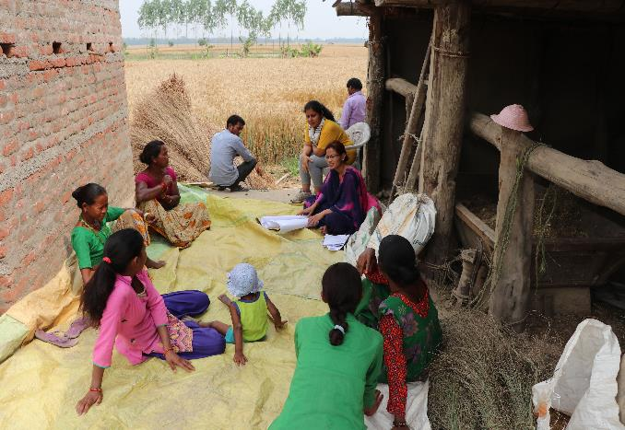
Representation
Representation relates to how different stakeholders can shape agendas and influence the critical decisions that impact their lives.
© Patrick Drown IWMI
Notes:
The second pillar of the social equity framework, representation, relates to how different stakeholders can shape agendas in the community or society, and can influence the critical decisions that impact their lives.
Measures are needed in Nexus initiatives to ensure that the diverse stakeholders we were just discussing are adequately represented across all phases, from planning to implementation and monitoring. Again, this includes particularly the communities and their members whose livelihoods depend directly on WEFE resources.

Slide 19



Representation
A GESI approach should ensure that marginalised groups can have influence in decision-making at different levels.
Those with the most to gain or lose from WEFE Nexus interventions often have the most limited influence.
Notes:
A gender equity and social inclusion approach should ensure that women and marginalised social groups can have a voice and influence in the processes shaping resource access and use at the household, community and higher decision-making levels.¹
Unfortunately, the stakeholders with the most to gain or lose from nexus interventions often have the least influence in intervention planning.
Reference:
¹ Agarwal, A., & Steele, A. (2016). Disability considerations for infrastructure programmes. London (UK): UK Department for International Development (DFID). http://dx.doi.org/10.12774/eod_hd.march2016.agarwaletal

Slide 20




Representation: Recognising and Fostering Higher Forms of Participation
Six levels of participation
Not all participation is created equal
Form of participation | Characteristic features
Interactive (empowering) participation | Having voice and influence in the group’s decisions
Active participation | Expressing opinions, whether or not solicited, or taking initiatives of other sorts
Activity-specific participation | Being asked to (or volunteering to) undertake specific tasks
Consultative participation | Being asked an opinion in specific matters without guarantee of influencing decisions
Passive participation | Being informed of decisions ex post facto; or attending meetings and listening in on decision-making, without speaking up
Nominal participation | Membership in the group
Notes:
This table¹ shows that not all participation in decision-making is equal in nature. There are many forms or levels of participation. Some participation can be quite nominal – for example, when someone is part of a group or project, but they do not actually engage actively or influence decisions. In contrast, in the most interactive or empowering form of participation, everyone is able to interact as peers and to express views with equal weight. This is also called ‘participatory parity’.
Other types of participation include consultative participation where people are asked an opinion in specific matters, without guarantee that they could actually influence decisions, and active participation where people express opinions or take initiative of their own. Because of social norms and inequalities, active participation is typically difficult for marginalised groups, without systematic efforts to involve them.
Achieving interactive or empowering participation requires ongoing negotiation and management of unequal power relations and conflicting interests. This is a challenging process, particularly as there are often limited resources, skills and trust among different participants.²
References:
1 Agarwal, B. (2001). Participatory exclusions, community forestry, and gender: An analysis for South Asia and a conceptual framework. World Development, 29(10), 1623-1648. https://doi.org/10.1016/S0305-750X(01)00066-3
2 Vermunt, D.A., Verweij, P.A., & Verburg, R.W. (2020). What hampers implementation of integrated landscape approaches in rural landscapes? Current Landscape Ecology Reports, 5(4), 99-115.

Slide 21

Representation: Recognising and Fostering Higher Forms of Participation
Meaningful participation requires addressing context-specific barriers.
Empowering participation and bottom-up learning requires continuously asking:
What voices are being heard at the different stages of decision-making processes, and what is the weight and legitimacy given to diverse voices?
Notes:
Enabling marginalised groups to meaningfully participate in nexus initiatives requires addressing the barriers they face, which depend on the group, place and time. To understand and lift these barriers, interventions must carefully consider the local context, including power relations and the history of water, energy, agriculture and environment sector development in the project area.
Targeted measures are needed to ensure that women and other less powerful actors can express their voices and priorities and that their views are meaningfully considered (i.e., what is called active and interactive/empowering participation in the participation visual just presented). Inviting these groups to attend a multi-stakeholder meeting is not enough, as they may not be able to express their views, influence the agenda, or engage on equal footing with other, more powerful groups. Participation then remains as nominal, passive or consultative only.
Empowering participation and bottom-up learning requires continuously asking: What voices are being heard at the different stages of decision-making processes, and what is the weight and legitimacy given to diverse voices?
Interactive (or empowering) participation can be supported, for example, by a combination¹ of:
Centering meetings on issues that are important to women and other marginalised groups
Establishing quotas for women’s and men’s participation, consultation, decision-making and voting
Selecting safe and easily accessible meeting venues, organizing child care and hygienic sanitary facilities
Giving enough space and time for collective learning, including in informal settings, smaller and single-gender groups, with safe space for expressing opinions and ideas
Being explicit and deliberate about how and why various inclusive tactics are being used
Allocating adequate financial and technical resources to supporting inclusion from the beginning
Mobilising the right skills to support a rigorous action learning initiative
Strengthening local capacities for conflict mediation and negotiating power imbalances.
The case study at the end of the module gives more examples of how to support interactive/empowering participation.
References:
¹ Zaremba, H., Elias, M., Devi, J.T., & Priyadarshini, P. (2021). Inclusive participatory approaches: A facilitator’s guide. Rome (Italy): Bioversity International. 24 p. ISBN: 978-92-9255-234-3 https://cgspace.cgiar.org/handle/10568/117461

Slide 22





Redistribution
Redistribution refers to an intentional effort to bring more equity to how rights and goods, as well as costs, risks and responsibilities, are distributed in a society. These rights and goods give power (including power over others) to those who control them.
Gender,
class structures & other social differences & inequalities
Resource access and control
Empower or marginalise
Notes:
Redistribution is the third and final pillar of the social equity framework. It refers to an intentional effort to bring more equity to how rights and goods, as well as costs, risks and responsibilities, are distributed in a society.
Rights to access and control resources shape - and are shaped by - gender, class structures and other social differences and inequalities that empower some people and groups while marginalising others.^{1,2,3.} These rights over resources and goods give power (including power over others) to those who control them, and so they can feed either further marginalisation or empowerment.
The other two pillars of the framework, recognition and representation, are goals in and of themselves, as they are essential to fairness and human dignity. They are also important to ensure that the costs, benefits and risks of Nexus initiatives are equitably distributed – which generally implies a need for redistribution.
References:
¹ Fraser, N. (2010). Who counts? Dilemmas of justice in a Postwestphalian World. Antipode, 41, 281-297. https://doi.org/10.1111/j.1467-8330.2009.00726.x
² Tilly, C. (1998). Durable Inequality. Berkeley (USA): University of California Press.
³ Ridgeway, C.L. (2011). Framed by gender: How gender inequality persists in the modern world. Oxford (UK): Oxford University Press.

Slide 23



Redistribution: Understanding Different Types of Livelihood Assets
A Sustainable Livelihoods Framework can be used to examine the distribution of costs, benefits and risks in WEFE Nexus interventions, and help identify ways to achieve a more equal distribution.
Natural
Political
ASSETS
Human
Financial
Social
Physical
Notes:
The Sustainable Livelihoods Framework illustrates the different types of tangible and intangible assets that resource users can draw upon to secure their livelihoods, and how these assets interact with each other ^{1, 2, 3}.
Assets can take many forms, including:
Natural capital such as land, water, fuelwood, wild food sources, or genetic resources
Physical capital such as irrigation and road infrastructure, transport, electricity, tools and machinery, storage, or production inputs like seed, fertilisers, and pesticides.
Financial capital such as regular income, savings, liquid assets, or formal and informal credit facilities.
Human capital such as knowledge and skills, education and training, health, nutrition, or capacity to work.
Social capital such as membership in formal and informal groups like Water User Associations and producer groups, collaboration, or access to opportunities through social networks.
Political capital such as citizenship, enfranchisement, or effective participation in governance.
The framework helps understand how costs (or loss of assets), benefits (or gains in assets), and risks are distributed among different stakeholder groups. It also helps grasp the trade-offs and synergies among assets that may result from Nexus interventions.^{1, 2, 3}
Key characteristics of the framework are that:
Assets are interdependent and partially interchangeable
Access to social and political assets is relational: as some social groups gain access to these capitals, other groups may lose out or give up power
Social structures and norms that impact resource users’ options have been shaped through historical processes, policies and mechanisms
In an interconnected world, changes in an asset in one location are affected by resource use and decision-making in other geographies.
References:
¹ DFID (1999). Key sheets for sustainable development: Overview. London (UK): UK Department for International Development (DFID).
² Scoones, I. (1998). Sustainable rural livelihoods: A framework for analysis. IDS Working Paper no 72. Sussex (UK): Institute of Development Studies.
³ Natarajan, N., Newsham, A., Rigg, J., & Suhardiman, D. (2022). A Sustainable Livelihoods Framework for the 21st century. World Development, 155, 105898. https://doi.org/10.1016/j.worlddev.2022.105898

Slide 24
Redistribution
Which groups would gain which types of assets or resources?
Which groups would lose access to and control over assets or resources as a result of interventions?
How do the planned interventions affect the availability, flows and distribution of different types of assets among diverse social groups?
To identify how WEFE Nexus interventions may affect the distribution of costs and benefits among different social groups, key questions include:
What structures, processes, checks and balances are needed to level the playing field and improve opportunities for women and marginalised social groups?
How do history and context (policies, norms, other institutions and markets) influence the distribution of costs, risks and benefits among social groups?
Notes:
In addition to asking these questions at the planning stage of an intervention, to shape intervention design, these questions should also be asked throughout the intervention. In doing so the questions help identify how WEFE Nexus interventions may affect the distribution of costs and benefits among different social groups.

Slide 25

What indicators can help understand the effects of interventions on gender equity and social inclusion?
Redistribution
What participatory monitoring approaches can support adaptive learning toward more equitable outcomes?
What alarm systems and safeguards are needed to mitigate and address unintended negative consequences?
Which trusted actors can play a part in these early warning systems to ensure interventions harm no one?
Monitoring and evaluation (M&E)
Notes:
Systematic monitoring is needed to reduce risks of harm to women or other marginalised social groups that may arise from an intervention. These questions can help monitor how gender equity and social inclusion are realised during project or programme implementation.

Slide 26

Your turn!
How can technology interventions affect the distribution of assets between stakeholder groups?
Discuss in groups.
Notes:
Please use Interactive session 2 sheet for instructions.
Suggested duration: 50 mins
- 25 min discussion
- 10 min for reporting back to the group
- 15 min for plenary discussion
This exercise is best done following the first interactive session 1. of the module where the participants first identify the WEFE management context and stakeholders they want to discuss. If doing this session 2 as a stand-alone exercise, please add 10-15 min additional discussion time to first identify the context and stakeholders.
Table 2, pp.14-15 of the following guideline provides an example of possible impacts of solar irrigation projects on the distribution of assets among stakeholders:
Jalonen, R., et al. 2022. Gender equity and social inclusion in the water-energy-food-ecosystems (WEFE) nexus: Frameworks and tools for moving from resource-centric to people-centric WEFE nexus approaches. Alliance of Bioversity International and International Center for Tropical Agriculture (CIAT), Rome, Italy. Available at: https://hdl.handle.net/10568/127383.

Slide 27
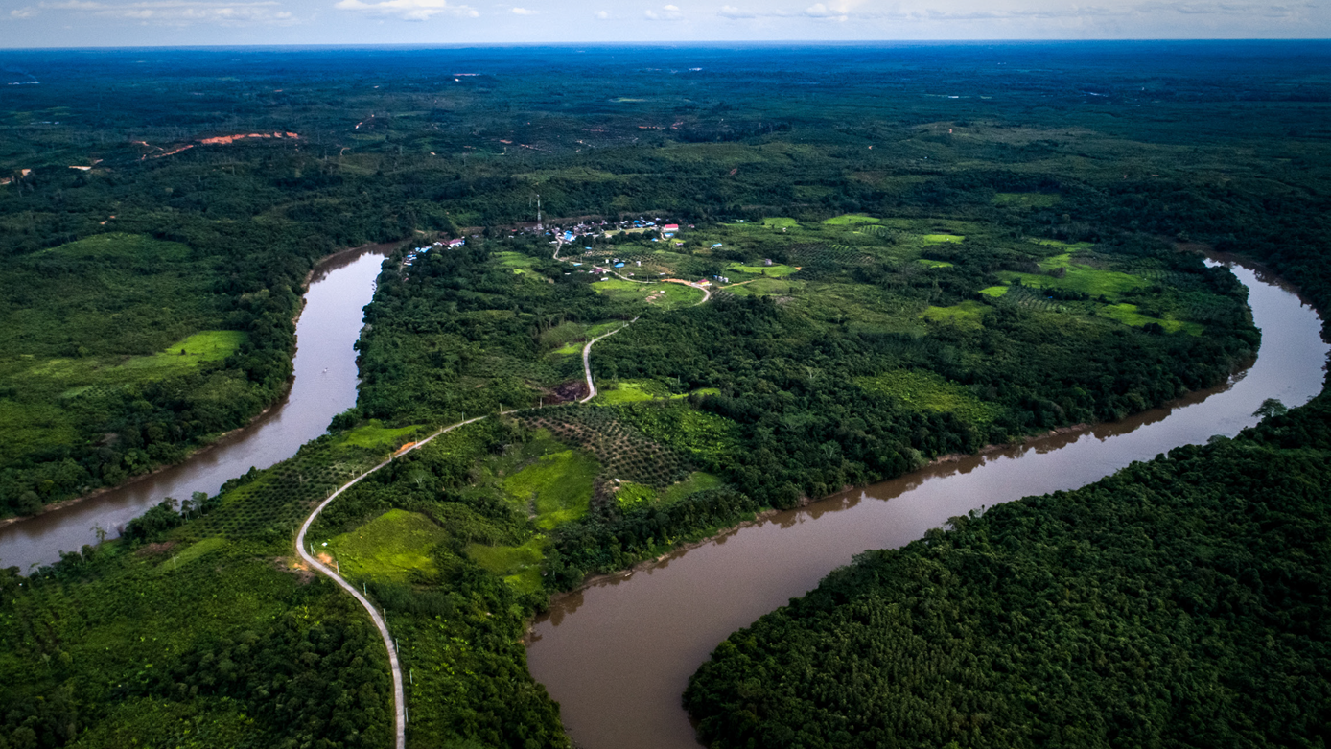
© Nanang Sujana CIFOR
4: Case study
Adaptive collaborative management in Indonesia for empowering community members in natural resource management
Notes:
This case study from Indonesia demonstrates collaborative process approaches that can be used to strengthen resource users’ capacities and empower them to identify and implement their own solutions for sustainable resource management.
These approaches place local people living closest to WEFE Nexus resources at the heart of decision-making, in collaboration with other key stakeholders.
They contribute to a sense of ownership among participants, which is crucial for sustainability after project support ends.
----------------
Note: The case study can be covered during the lesson, or course participants can be asked to self-study it. The case study is available at the below link.
If you opt for self-study, please skip to slide no. 34, which begins the synthesis of the module.
Jalonen, R., et al. 2022. Gender equity and social inclusion in the water-energy-food-ecosystems (WEFE) nexus: Frameworks and tools for moving from resource-centric to people-centric WEFE nexus approaches. Alliance of Bioversity International and International Center for Tropical Agriculture (CIAT), Rome, Italy. Available at: https://hdl.handle.net/10568/127383. Pages 16-19.

Slide 28
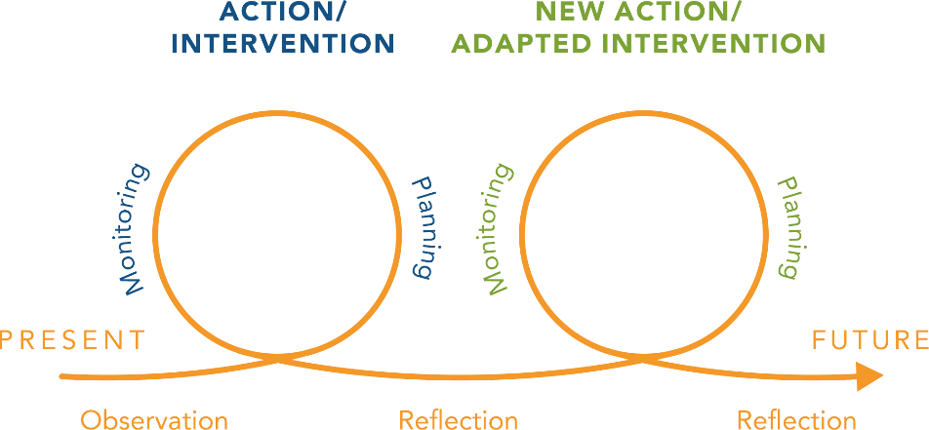
Adaptive collaborative management (ACM)
Adaptive collaborative management (ACM) is an iterative and participatory process that centres on cycles of shared action, learning and reflection.
It relies on active participation of those who are typically marginalised from decision-making, as well as other stakeholders as the intervention unfolds.
Notes:
The so-called adaptive collaborative management is an iterative and participatory process that centres on cycles of shared action, learning and reflection. It relies on the active participation – in the case of our Indonesia example, that of local forest users – including those who are typically marginalised from decision-making, as well as other stakeholders as the intervention unfolds.
The adaptive collaborative management learning cycle starts with observation of issues in resource use that are relevant to the stakeholders; collaboratively planning actions to address the issues; monitoring the effectiveness and equity of the actions; and reflecting on lessons learned, before planning a new cycle of actions.
This learning cycle engages all three pillars of the social equity framework – recognition, representation and redistribution – to achieve sustainable and equitable Nexus solutions. We will now look at these through examples from the Indonesian case study.
Reference (including figure):
¹ Kusumanto, T., Yuliani, E.L., Macoun, P., Indriatmoko, Y. & Adnan, H. (2005). Learning to adapt: Managing forests together in Indonesia. Bogor (Indonesia): Center for International Forestry Research (CIFOR). https://doi.org/10.17528/cifor/001780

Slide 29


Recognition
In three Indonesian communities, stakeholder analysis was included in an early step in the learning process to support multiple users to co-manage forest resources through ACM. The analysis asked, among other questions:
Who are the stakeholders in forest management in this area?
Who should be involved in the process?
Baru Pelepat Village, Jambi | Rantau Layung and Rantau Buta Villages, East Kalimantan
Nomadic Orang Rimba (women and men) Original community (women and men) Settler community (women and men) Village elite Youth Customary institution Village government Religious institution Women’s groups | Farmer groups (women and men) Youth (women and men) Forest workers (all men) Elderly (all men) Village elite (formal government officials and customary leaders)
Notes:
ACM was used to empower multiple users to co-manage forest resources in three communities in Indonesia.
This table illustrates key actors identified through the stakeholder analysis activities conducted in each community. This corresponds to the ‘recognition’ pillar of the social equity framework.
The facilitation team spent months visiting each community to get to know the local contexts and to build trust with the many different segments of each community. These key stakeholders were then involved throughout the intervention, and their knowledge systems, experiences and priorities were considered as equally valid and important throughout the planning and reflection process.
Reference:
Kusumanto, T., Yuliani, E.L., Macoun, P., Indriatmoko, Y. & Adnan, H. (2005). Learning to adapt: Managing forests together in Indonesia. Bogor (Indonesia): Center for International Forestry Research (CIFOR). https://doi.org/10.17528/cifor/001780

Slide 30





Representation
Shared skills and knowledge
Collective working
Trust
ACM
principles
Information flow
Conflict management
Intentional learning
Communication
Active
participation
Notes:
Secondly, ACM is particularly well suited to advance representation, the second pillar of the framework, as it is designed to enable action learning among community members with different understandings and experiences.
Active participation of all key stakeholders throughout the entire ACM intervention is central to learning and progressing toward the desired resource management goals or shared vision.^{1,2}
Along this iterative cycle, ACM principles focus on the following:
Effective communication and information flows among stakeholders
Active participation and wider representation in decision-making and negotiation of all important stakeholders
Mechanisms to manage conflicts and adapt to rapid changes, surprises and uncertainty
Intentional learning and experimentation
Institutional willingness (that is, attitudes) and capacity (that is, skills and resources) to learn and respond to learning
High mutual respect, trust and transparency
Shared knowledge and skills
Collective planning, decision-making, action and monitoring, including attention to relationships within and between human and natural systems.
References:
¹ Kusumanto, T., Yuliani, E.L., Macoun, P., Indriatmoko, Y. & Adnan, H. (2005). Learning to adapt: Managing forests together in Indonesia. Bogor (Indonesia): Center for International Forestry Research (CIFOR). https://doi.org/10.17528/cifor/001780
² Giller, K.E., Leeuwis, C., Andersson, J.A., Andriesse, W., Brouwer, A., Frost, P., Hebinck, P., et al. (2008). Competing claims on natural resources: What role for science? Ecology and Society, 13(2).

Slide 31
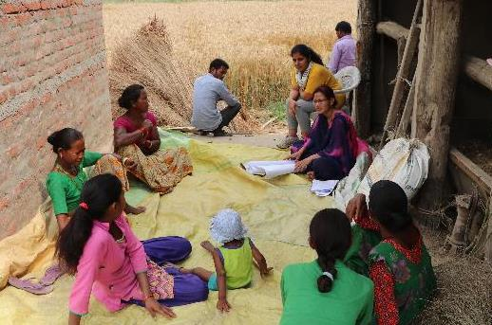
Representation
Inclusive decision-making = collective understanding of current socio-ecological processes, interactions and power struggles related to resource management
Shared learning strengthened capacity and confidence to:
Manage new information
Negotiate
Organise and gain institutional competence
Problem-solving
© Patrick Drown IWMI
Notes:
In this case study, tools used to support inclusive decision-making included participatory boundary or social mapping exercises, and small-group meetings among different sets of stakeholders to undertake shared visioning and priority-setting exercises that addressed livelihood needs or resource scarcities.
Over time, as more and more was shared, participants developed a collective understanding of the issues. These included current socio-ecological processes (for example land degradation), as well as interactions and power struggles related to natural resource management (for example land claims, pressures from the palm oil industry, and settler groups’ differing needs and interests).
The processes of shared learning, including about different authority systems, strengthened the capacity and confidence of marginalised groups, to manage information, negotiate, organise themselves, and solve problems.
Among other changes observed, village women were represented in local resource management decision-making for the first time. Villagers (both women and men) also observed greater trust and ability to communicate and network with other communities and with representatives of logging companies and the government.

Slide 32
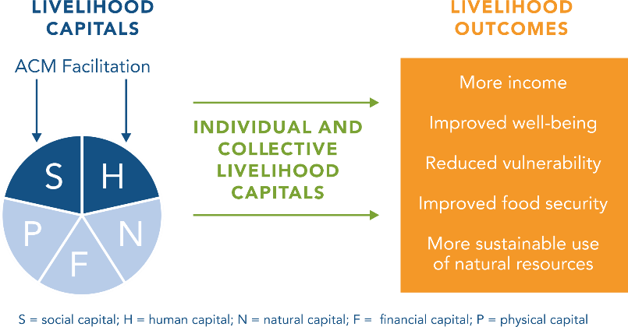
Redistribution
The ACM process drew on the Sustainable Livelihoods Framework to monitor changes in the capitals of the three communities
Notes:
The Adaptive Collaborative Management process was designed to achieve and monitor changes in the social, human, natural, financial and physical capital in the three ACM intervention communities. These are the different types of capitals or assets in the Sustainable Livelihoods Framework that we discussed earlier.
The most evident benefits from the ACM process in the Indonesian communities included:
Strengthened human and social capital (including in participants’ leadership skills)
Improved technical knowledge (including mapping skills and recording and analysing data)
Improved communication and negotiation abilities.
Stakeholders of different social status developed the motivation and confidence to improve their relationships with each other.
ACM’s bottom-up agenda-setting and shared learning approach also inspired changes in other types of capital by supporting livelihood strategies that not only improved incomes but also reduced vulnerability, increased community members’ well-being, improved food security and led to more sustainable use of natural resources.
Outcomes across capitals should be assessed for different stakeholders, including those most marginalised, to support their equitable distribution.
Figure source:
Kusumanto, T., Yuliani, E.L., Macoun, P., Indriatmoko, Y. & Adnan, H. (2005). Learning to adapt: Managing forests together in Indonesia. Bogor (Indonesia): Center for International Forestry Research (CIFOR). https://doi.org/10.17528/cifor/001780

Slide 33

In summary
This case study shows that it is possible, over time, to build collective learning and trust across the phases of WEFE interventions by being interactive, interdisciplinary, multilevel, multistakeholder, collaborative and iterative.
© Bobby Mc Leod / Unsplash
Notes:
This case study shows that it is possible, over time, to build collective learning and trust across the phases of WEFE interventions by being interactive, interdisciplinary, multilevel, multistakeholder, collaborative and iterative.
In summary:
Marginalised groups with a stake in Nexus interventions should be recognised as legitimate actors.
These stakeholders should actively participate in decision making about processes that affect their lives.
Specific measures will be needed to support the interactive participation of these groups.
Defining a clear monitoring strategy, with GESI indicators, is crucial for tracking progress, commitments and agreements.
By placing gender and inclusion at the heart of Nexus interventions, it is possible to advance a more equal and sustainable management of the WEFE Nexus.
Reference:
Kusumanto, T., Yuliani, E.L., Macoun, P., Indriatmoko, Y. & Adnan, H. (2005). Learning to adapt: Managing forests together in Indonesia. Bogor (Indonesia): Center for International Forestry Research (CIFOR). https://doi.org/10.17528/cifor/001780

Slide 34
5: Synthesis
Notes:
That brings us towards the end of the module. Let’s now summarise what we have learned against the learning objectives we started with.
Resources Pictures:
Bottom left: © Manon Koningstein IWMI
Top left: © Subedi LI-BIRD
Right: © David Brazier IWMI

Slide 35

Learning objective 1
A gender equity and social inclusion (GESI) lens highlights the unevenly distributed constraints and opportunities that shape decisions, resource access and benefits among different WEFE Nexus stakeholders.
Understanding these inequalities is important for developing more equitable and sustainable WEFE Nexus initiatives.
Explain the importance of GESI for achieving sustainable development outcomes in the
WEFE Nexus
Notes:
The first learning objective was to explain the importance of gender equity and social inclusion for achieving sustainable development outcomes in the WEFE Nexus.
By looking at the WEFE Nexus through a gender and social inclusion lens, we have seen how the constraints and opportunities that shape decisions, resource access and benefits among Nexus stakeholders are unevenly distributed .
Understanding these inequalities is important for developing more equitable and sustainable WEFE Nexus research and development initiatives.
Nexus approaches must look beyond resource conservation, productivity and efficiency objectives to consider^{1,2}:
Policies, institutions and practices that shape the access and control, use, governance and management of water, energy, food and the environment, and that generate and maintain inequalities.
Measures that can expand women’s and other disadvantaged groups’ access to these resources and related decision-making processes and benefits.
References:
¹ Allouche, J., Middleton, C., & Gyawali, D. (2015). Technical veil, hidden politics: Interrogating the power linkages behind
the nexus. Water Alternatives, 8(1), 610-626. https://doi.org/https://www.mdpi.com/2071-1050/13/4/1919
² Natarajan, N., Newsham, A., Rigg, J., & Suhardiman, D. (2022). A Sustainable Livelihoods Framework for the 21st century.
World Development, 155, 105898. https://doi.org/10.1016/j.worlddev.2022.105898

Slide 36
Learning objective 2
Development interventions, including those focused on the WEFE Nexus, have uneven effects on different social groups.
Interventions should ensure that they reduce (rather than increase) power imbalances and inequality and reverse (rather than accentuate) resource degradation.
Describe common GESI challenges and issues that WEFE projects face
Notes:
The second learning objective was to describe common gender and social inclusion challenges and issues that Nexus projects and programmes face. We learned that development interventions, including those focused on the WEFE Nexus, have uneven effects on different social groups.
Influential stakeholders often dominate decisions and capture the bigger share of benefits. In contrast, those with less power may be unable to influence agendas or get substantial benefits from interventions. Marginalised groups may also bear a disproportionate share of the costs and risks of interventions. Others may be excluded altogether. These dynamics, and how they may change over time, should be considered and addressed to ensure that interventions indeed ease power imbalances and reverse resource degradation.

Slide 37
Learning objective 3
A GESI lens and the social equity framework, with its concepts of recognition, representation, redistribution, and participatory parity help to understand how interventions can have unequal effects on the many social groups who depend on WEFE Nexus resources.
Carefully integrating GESI considerations throughout all phases of WEFE Nexus initiative planning, implementation and monitoring will contribute to more socially equitable and resilient Nexus management across scales and over time.
Describe the main steps for better addressing GESI considerations
Notes:
The final learning objective was to be able to describe the main steps for better addressing gender and social inclusion considerations in WEFE Nexus initiatives.
We saw how the social equity framework’s principles of recognition, redistribution and representation, together with its overarching concern for participatory parity, can offer entry points to identify and address these gender and inclusion considerations.^{1,2}
Recognition is the starting point for enabling participation, accountability and inclusion processes. Stakeholder analysis is a useful tool to identify relevant stakeholders, including those most marginalised, so that they can be engaged in the identification and implementation of solutions.
Marginalised and other actors should be represented as equals in the governance and management of WEFE resources, allowing all to express their needs and priorities for resource management. This calls for reflection throughout the implementation of interventions on whose voices shape the agenda and ensuring that there are sufficient resources to enable cycles of reflection, action and learning in favour of more marginalised groups.
Finally, the potential benefits, costs and risks of interventions for different stakeholder groups must be assessed. The Sustainable Livelihood Framework offers a multidimensional perspective on assets to illuminate these potential or actual outcomes. Outcomes will vary for different stakeholders and must be examined for each group to support their equitable distribution. Gender equity and social inclusion approaches should include systematic monitoring to reduce risks of harm to women and other marginalised social groups that may arise from an intervention.
References:
¹ Fraser, N. (1998). Social justice in the age of identity politics: Redistribution, recognition, participation. WZB Discussion Paper, No. FS I 98-108. Berlin (Germany): Wissenschaftszentrum Berlin für Sozialforschung (WZB).
² Fraser, N. (2005). Mapping the feminist imagination: From redistribution to recognition to representation. Constellations, 12(3), 295-307. https://doi.org/https://doi.org/10.1111/j.1351-0487.2005.00418.x

Slide 38
Over to you…
Any questions on this lesson?
What thoughts did it generate?
How do the issues apply to your own work?

Slide 39




Contact
Alliance of Bioversity International and CIAT
CGIAR Initiative on
NEXUS Gains
alliancebioversityciat.org
Email: marlene.elias@cgiar.org
Via di San Domenico, 1, 00153 Rome, Italy
cgiar.org/initiative/
nexus-gains
Email: nexusgains@cgiar.org
Photo credits: Anggit Rizkianto / Unsplash; Bobby Mc Leod / Unsplash; CGIAR Research Program on Water, Land and Ecosystems; David Brazier / IWMI; J. van de Gevel / Bioversity International; Jason Cooper / Unsplash; Manon Koningstein / IWMI; Marc St / Unsplash; Nanang Sujana / CIFOR; Paolo Nicolello / Unsplash; Patrick Drown / IWMI; S Subedi / LI-BIRD; Samurdhi Ranasinghe / IWMI; Tom van Cakenberghe / IWMI; Tomáš Malík / Unsplash
@BiovIntCIAT_eng
@Alliance of Bioversity International and CIAT
Alliance of Bioversity International and CIAT
@bioversityciat

Slide 40
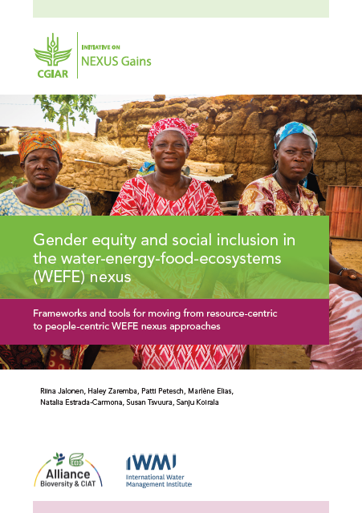
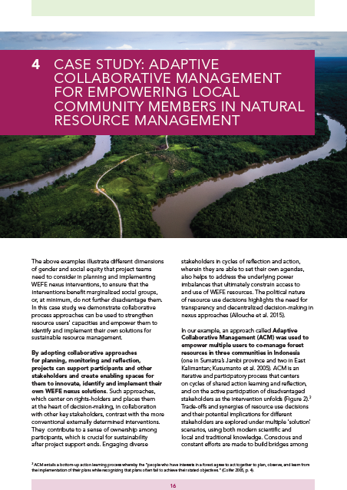
Note
This module / lesson is based on a guideline developed by the CGIAR Initiative on Nexus Gains:
Jalonen, R., Zaremba, H., Petesch, P., Elias, M., Estrada-Carmona, N., Tsvuura, S., Koirala, S. 2022. Gender equity and social inclusion in the water-energy-food-ecosystems (WEFE) nexus: Frameworks and tools for moving from resource-centric to people-centric WEFE nexus approaches. Alliance of Bioversity International and International Center for Tropical Agriculture (CIAT), Rome, Italy. Available at: https://hdl.handle.net/10568/127383
Notes:
How to cite this learning module:
Jalonen, R., Elias, M., Zaremba, H., Petesch, P., Estrada-Carmona, N., Tsvuura, S., Koirala, S. 2023. Gender equity and social inclusion in the water-energy-food-ecosystems (WEFE) nexus: Frameworks and tools for moving from resource-centric to people-centric WEFE nexus approaches. Online learning module. Alliance of Bioversity International and International Center for Tropical Agriculture (CIAT), Rome, Italy.

Slide 42
Global Nexus Secretariat
c/o Deutsche Gesellschaft für Internationale Zusammenarbeit (GIZ) GmbH
Dag-Hammarskjöld-Weg 1-5
65760 Eschborn
Germany
+49 6196 79-7222
nexus@giz.de
www.water-energy-food.org

