Slide 1
Module III - Case Studies
For cross-policy making and related project design and planning

Slide 2
Overview of case studies
Region | Scale (local, regional, national, transboundary) | Sectors (water, agriculture, energy) | Solutions (technical, nature-based, governance, focus on challenges)
Europe
LAC
LAC
MENA Region
Niger Basin
SADC
Policy framework for WEF coordination, Germany
Hydropower in the Reventazón River, Costa Rica
Mobile solar powered irrigation systems (SPIS), Bolivia
The Sahara Forest Project, Jordan
The Lagdo Dam in the valley of the Benue, Cameroon
WEF-Nexus coordination in the lower Kafue basin, Zambia

Slide 3
Mobile solar powered irrigation systems (SPIS), Bolivia
Latin America & the Caribbean

Slide 4
Context of Bolivia
Geographic situation:
Bolivia is a landlocked country
Diverse topography: from the Andes Mountains to the Amazonian lowlands
Climatic situation:
Humid season: November – March
Dry season: April – October
Average annual temperature: 21.01 °C
Average annual precipitation: 1091.94 mm
Major challenges:
Poverty, shrinking water sources because of climate change, lack of sectoral WEF securities
Source: WorldAtlas, 2022
Notes:
Notes:
Geographic situation:
Bolivia is a landlocked country, surrounded by Brazil, Paraguay, Argentina, Chile and Peru
It has a very diverse topography:
Ranges from the highlands of the Andes Mountains (5,000 meters above sea level) to the plains of the Amazonian lowlands (less than 500 meters above sea level)
West: Andean area and arid highlands with large cultivated areas
Middle of the country: the sub-Andean and semi-tropical valleys
East: tropical lowlands
Climatic situation:
Humid season: November – March
Dry season: April – October
Mean annual temperature is 21.01 °C
Mean annual precipitation is 1091.94 mm
Major challenges:
Poverty:
Bolivia is one of the poorest countries in Latin America and the Caribbean
In 2014, 39 % of the population lived below the poverty line
Shrinking water sources
Bolivia is expected to be one of the most affected countries by water loss as a consequence of climate change
In 2014, 18 % had no drinking water supply system and 43 % had no access to wastewater disposal
This causes conflicts of interests between the WEF sectors because they are all interconnected with water and they already record alarming numbers regarding their sectoral security
Energy sector: in 2014, 18 % had no a power connection
Food sector: in 2014, 20 % were malnourished
Sources:
Climate Change Knowledge Portal, ‘Bolivia: Climatology’, available at: https://climateknowledgeportal.worldbank.org/country/bolivia/climate-data-historical?msclkid=323238b8bb2711ec941fc4905c4b777a
GIZ, ‘Working together to develop the water, energy and food security sectors’, available at: https://www.giz.de/en/worldwide/43105.html
Navarro, G., & Fereira, W. (2004) ‘Zonas de vegetación potencial de Bolivia: una base para el análisis de vacíos de conservación’, Revista Boliviana de Ecología, 15, 1–40.
Vicente-Serrano, S.M. et al. (2016), ‘Average monthly and annual climate maps for Bolivia’, Journal of Maps, 12:2, 295-310.
Winters, C. (2012), ‘Impact of climate change on the poor in Bolivia’, Global Majority E-Journal, 3, 33–43.
Image Reference:
WorldAtlas (2022), ‘Maps of Bolivia’, available at: https://www.worldatlas.com/maps/bolivia

Slide 5
Mobile solar pumping in Bolivia: Overview
Parameters | Description
Sectors involved | Water, energy, and agriculture
Scale | Local
Key actors | Recipients: technical staff (public/ private sector), farmers Planning and implementation by PAEGC, GIZ, BMZ, EU
Nexus challenges | Servere deficiencies in water, energy and food security Lack of cross-sectoral planning
Solution type | Technical
Implementation challenges | Risk of groundwater exploitation Limited technology and high costs
Success factors | Technical adaptability Structural anchoring
Notes:
Notes:
The first case study presented here is located in Bolivia in Latin America. It deals with the implementation of a mobile solar pumping system which aims to improve agricultural irrigation in a sustainable manner.
Let‘s have a look on the overall parameters of the project:
All three Nexus sectors are involved in this project: water, energy and agriculture
The project was realised in rural communities, thus at a local scale
Key actors:
The project addresses technical staff from the public and private sector and farming families
It was set up by the international initiative Powering Agriculture – An Energy Grand Challenge for Development (PAEGC)
PAEGC was created in 2012 by the United States Agency for International Development (USAID), the Swedish International Development Cooperation Agency (SIDA), the German Federal Ministry for Economic Cooperation and Development (BMZ), the energy company Duke Energy Corporation and the Overseas Private Investment Corporation (OPIC)
Responsible for the implementation of the project are GIZ (on behalf of the German Federal Ministry for Economic Cooperation and Development (BMZ) and the European Union
Nexus challenges:
Bolivia is one of the poorest countries in Latin America and faces severe deficiencies in water supply, power connection and food security
In particular, 18% of the population lacked a drinking water supply system, 43% did not have access to a wastewater disposal, 18% lacked power connection, and 20% suffered from malnutrition
Additionally, the three WEF sectors lack mutual cooperation which prevents them from effective cross-sectoral planning
The type of solution to which the project responds fits into the category of technical and engineering
Implementation challenges:
The implementation of a solar pumping system for irrigation is accompanied by the risk that the abstraction of (ground)water will exceed the availability of the limited source
Additionally, in Bolivia technology is still limited and costs could be more affordable
The success of the project not only lies in the great adaptability of mobile solar pumping equipment but also refers to a superordinate motive → due to the embedment in the international initiative PAEGC the project has a reliable structural anchor in a wider community
Sources:
Energypedia (c), ‘Toolbox on Solar Powered irrigation systems (SPIS): Safeguard Water: Module Aim and Orientation‘, available at: https://energypedia.info/wiki/SPIS_Safeguard_Water
GIZ, ‘Working together to develop the water, energy and food security sectors’, available at: https://www.giz.de/en/worldwide/43105.html

Slide 6
Mobile solar pumping in Bolivia: WEF Nexus interactions
Mobile Solar Powered Irrigation Systems (SPIS) are on the rise
Promote the use of renewable energies for irrigated agricultural production
Particularly useful in rural areas with weak or lacking access to electricity
Benefits of mobile SPIS:
Secured and sustainable access to energy supply for pumping water for irrigation
Increased water and energy efficiency for irrigated food production
The flexibility of the equipment allows for an extensive use
Source: GIZ, 2018 a
Notes:
Notes:
Mobile Solar Powered Irrigation Systems (SPIS) are on the rise since 2010
They promote the use of renewable energies for irrigated agricultural production
Particularly useful in Bolivia’s rural areas with weak or lacking access to electricity
With regard to the WEF nexus, the following beneficial sectoral interactions can be observed:
Secured and sustainable access to energy supply for pumping water for irrigation and other uses:
Solar pumping represent an alternative to the use of conventional pumps (e.g. diesel-, gas- or petrol-driven) because they don’t rely on fuel supply
They offer a CO2-neutral and thus sustainable option (compared to a diesel generator a solar powered system can save about 1 kg of CO2 per kilowatt hour of output)
Prevents soil and ground water contamination by fuels and lubricants
Increased water and energy efficiency for irrigated food production
The flexibility of the equipment allows for an extensive use:
Solar panels are attached to wheels and can be moved to different sites
They require less maintenance than conventional pumps and don’t need physical attendance to be operated
By doing so, the solar pumping project explicitly empahsises the nexus approach by addressing the water, energy and food security equally and in a sustainable manner
Sources:
Energypedia, (a), Toolbox on Solar Powered irrigation systems (SPIS): Get informed: The Solar Alternative‘, available at: https://energypedia.info/wiki/SPIS_Toolbox_-_The_Solar_Alternative
Energypedia (c), ‘Toolbox on Solar Powered irrigation systems (SPIS): Safeguard Water: Module Aim and Orientation‘, available at: https://energypedia.info/wiki/SPIS_Safeguard_Water
GIZ (2018 a), ‘Equipo Móvil de Bombeo Solar: Manual de Capacitación‘, Eschborn, available at: https://uploads.water-energy-food.org/legacy/panel_solar_version_ue.pdf
Image Reference:
GIZ (2018 a), ‘Equipo Móvil de Bombeo Solar: Manual de Capacitación‘, Eschborn, available at: https://uploads.water-energy-food.org/legacy/panel_solar_version_ue.pdf

Slide 7
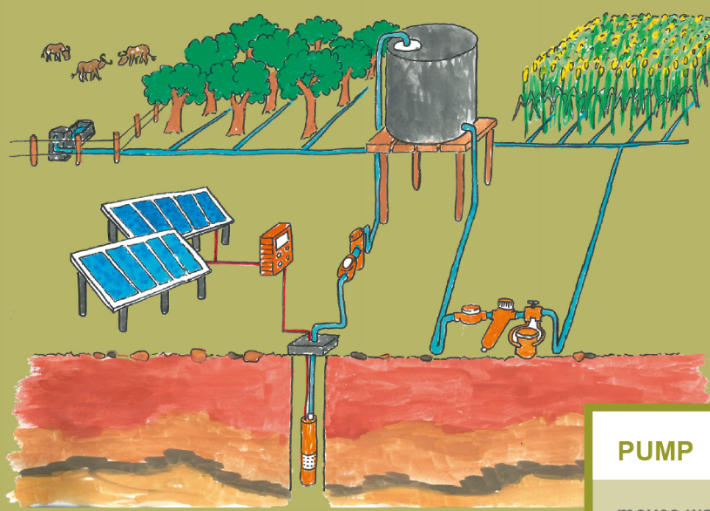
How to use a mobile SPIS
Solar panels generate renewable energy
Electric motor pump is activated and extracts groundwater
Water is now available for irrigation and livestock
SPIS can be moved flexibly to other fields
Source: Schultz (GIZ), 2018
Notes:
Notes:
But how does SPIS work? Let‘s have a look…
Solar pumping systems are primarily used in areas where power from the grid is not available. Instead, the power is generated by a solar generator
The energy generated activates an electric motor pump which extracts groundwater (or water from other sources)
The water can be stored in a water tank (optionally) or directly forwarded to irrigate the crops or provide water for the livestock
Due to the mobile feature of the solar pumping equipment, it can be used very flexibly (e.g. rotating at different fields)
In addition to submersible pumps which draw the water from deeper wells (as described above), a solar powered irrigation system can also consist of a surface pump. In general, this type of pump is used for water transport but it can also be applied in domestic water systems in order to obtain a higher water pressure.
Overall, SPIS supports farmers in becoming more independent from changing weather conditions (e.g. lack of rain) and thus strengthen their resilience towards climate change. Furthermore, the surplus energy can be used for other energy requiring processes (e.g. for processing food).
Sources:
Energypedia, (b), Toolbox on Solar Powered irrigation systems (SPIS): Get informed: Solar Powered Irrigation Systems‘, available at: https://energypedia.info/wiki/SPIS_Toolbox_-_Solar_-_powered_Irrigation_Systems
GIZ (2018 a), ‘Equipo Móvil de Bombeo Solar: Manual de Capacitación‘, Eschborn, available at: https://uploads.water-energy-food.org/legacy/panel_solar_version_ue.pdf
Image Reference:
Schultz, Robert (GIZ) (2018), ‘The SPIS Toolbox poster‘, available at: https://energypedia.info/images/a/ae/PA_PosterA0.pdf

Slide 8
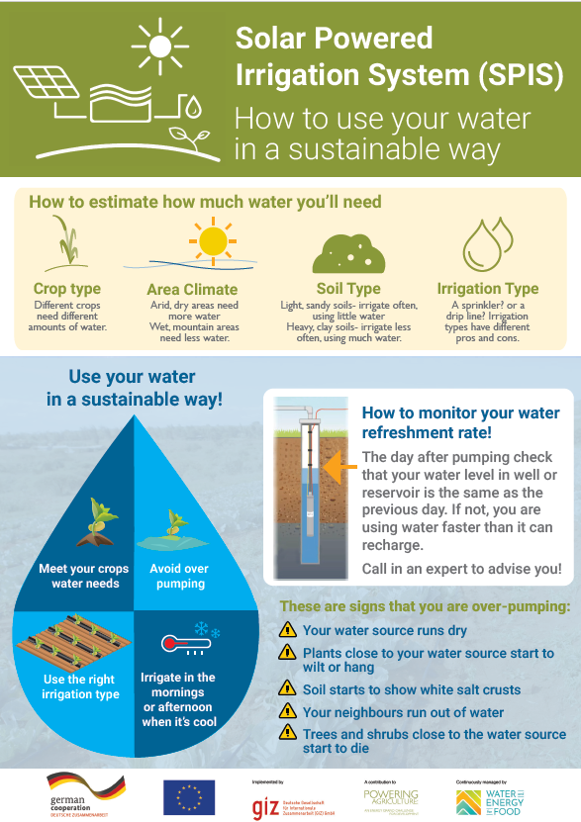
Implementation challenges
Since the energy generated by solar power is unlimited, there is a certain risk of groundwater overexploitation.
In order to avoid the risk, the following steps need to be considered:
Get informed about factors affecting the water demand
Follow fundamental sustainability recommendations
Ensure a constant monitoring and be aware of warning signals
1.
2.
3.
Source: modified from Energypedia, 2021
Notes:
Notes:
Besides the several benefits of SPIS there also exist some challenges. For example, solar energy can only be generated during the day (although there are possibilities to store the energy in a battery).
But the main disadvantage refers to the extraction of groundwater. Since the energy generated by sun power and required for water pumping is unlimited, there is a certain risk of groundwater exploitation. In order to avoid over-pumping, SPI needs to be sized and planned adequately.
In order to avoid the risk, the following steps need to be considered:
Get informed about factors affecting the water demand:
Crop type: Different crops need different amounts of water.
Area Climate: Arid, dry areas need more water. Wet, mountain areas need less water.
Soil Type: Light, sandy soils- irrigate often, using little water. Heavy, clay soils- irrigate less often, using much water.
Irrigation Type: A sprinkler? or a drip line? Irrigation types have different pros and cons.
Follow fundamental sustainability recommendations:
Meet your crops water needs
Avoid over-pumping
Use the right irrigation type
Irrigate in the mornings or afternoon when it’s cool
Ensure a constant monitoring and be aware of warning signals:
Monitoring: The day after pumping check that your water level in well or reservoir is the same as the previous day. If not, you are using water faster than it can recharge. Call in an expert to advise you!
These are signs that you are over-pumping:
Your water source runs dry
Plants close to your water source start to wilt or hang
Soil starts to show white salt crusts
Your neighbours run out of water
Trees and shrubs close to the water source start to die
Sources:
Energypedia, (a), Toolbox on Solar Powered irrigation systems (SPIS): Get informed: The Solar Alternative‘, available at: https://energypedia.info/wiki/SPIS_Toolbox_-_The_Solar_Alternative
Image Reference:
Energypedia (2021-04-22), ‘How to Use your Water in a Sustainable Way?’ available at: https://energypedia.info/wiki/File:GIZ_POSTER_1_English_Final.pdf

Slide 9
Potential of SPIS
The implementation of mobile SPIS in Bolivia is associated with:
Sustainable and secure water pumping
Sustainable and suitable energy production, especially in rural areas lacking electricity access
Increased agricultural productivity
A certain risk of groundwater overexploitation
→ Mechanism to strengthen Bolivia’s resilience to climate change
Source: GIZ, 2018 b
Notes:
Notes:
Summarised, the implementation of mobile SPIS in Bolivia is associated with a wide range of potentials:
SPIS represents a sustainable and secure alternative to traditional water pumping
Solar energy provides access to environmentally friendly and secure energy supply → particularly helpful in Bolivia‘s rural communities which often lack of access to electricity
Independence from weather conditions (e.g. rainfall) due to constant and controlled water availability increases the overall agricultural productivity
Nevertheless, the risk of groundwater exploitation is inherent in SPIS → therefore, several factors need to be taken into account within the planning of such a system
Finally, the successful implementation of mobile solar powered irrigation systems can work as a mechanism to strengthen Bolivia’s resilience to climate change.
Sources:
GIZ (2018 a), ‘Equipo Móvil de Bombeo Solar: Manual de Capacitación‘, Eschborn, available at: https://uploads.water-energy-food.org/legacy/panel_solar_version_ue.pdf
Image Reference:
GIZ (2018 b), ‘Curso Internacional en Sistemas de Bombeo // Bolivia se Capacita en Sistemas de Bombeo para Irrigación y Otros Usos’, available at: https://www.water-energy-food.org//events/curso-internacional-en-sistemas-de-bombeo-bolivia-se-capacita-en-sistemas-de-bombeo-para-irrigacion-y-otros-usos

Slide 10
Thank you for your time!

